Slide 1
Crude Oil Futures Case Study
Anantajit Raja

Slide 2
Data Structure Design
Multi-level hashmap to store data and allow for O(1) access
3 level hierarchy using product, month, year as keys
Value: expiry date
Stored in pickle format for (de-)serialisation/easy of load and reuse

Slide 3
Mapping Securities to Each Other
We query the data structure designed in Part 1 to map securities
There are 6 possible maps:
S -> G, S -> MG, G -> S, G -> MG, MG -> G, MG -> S
We can focus on just one particular security type (each has 4 possible direct maps), and the remaining 2 maps follow
E.g. if we pick all the maps for generic (highlighted), then the map of S to or from MG follow by composition S -> G -> MG or MG -> G -> S

Slide 4
Mapping Securities to Each Other (Continued)
Want to find S -> G, G -> S, G -> MG, MG -> G (generic direct maps)
Define all 6 possible maps (including MG -> S, S -> MG) to be ‘child functions’
Query the data structure using the child functions
Have a more flexible parent function(security, input security type, input date (range))
Maps any security to the remaining two
Determines which child functions are called
Final return: two dictionaries with input dates (in a range) as keys, and forms you map to (i.e. 2 of S/G/MG forms) as values

Slide 5
Mapping Securities to Each Other (Example Output)
querying_interface('COJAN2', 'monthly generic', '2024/11/28-2024/12/07’)
returns the two dictionaries for specific and generic forms:
({'2024-11-28': 'COF26', '2024-11-29': 'COF27', '2024-11-30': 'COF27', '2024-12-01': 'COF27', '2024-12-02': 'COF27', '2024-12-03': 'COF27', '2024-12-04': 'COF27', '2024-12-05': 'COF27', '2024-12-06': 'COF27', '2024-12-07': 'COF27'}, {'2024-11-28': 'CO13', '2024-11-29': 'CO24', '2024-11-30': 'CO24', '2024-12-01': 'CO24', '2024-12-02': 'CO24', '2024-12-03': 'CO24', '2024-12-04': 'CO24', '2024-12-05': 'CO24', '2024-12-06': 'CO24', '2024-12-07': 'CO24’})
querying_interface('COJAN2', 'monthly generic', '2024/11/28’)
is a single date query which would also work:
({'2024-11-28': 'COF26'}, {'2024-11-28': 'CO13’})
All queries execute in roughly 3ms

Slide 6
Intraday Seasonality Plot
First filter for the data we want: specific, within input time range
Use dictionaries from task 1 to slice the df
Map any (monthly) generic or specific onto the specific, if it exists within the time range
Need to use both MG -> S, G -> S maps from task 1
Be wary of the bounds of the data when mapping to specifics – some may not exist!
Open - Open except at 19:00:00, in which case Close - Open
cumsum() the price changes for individual date to get value

Slide 7
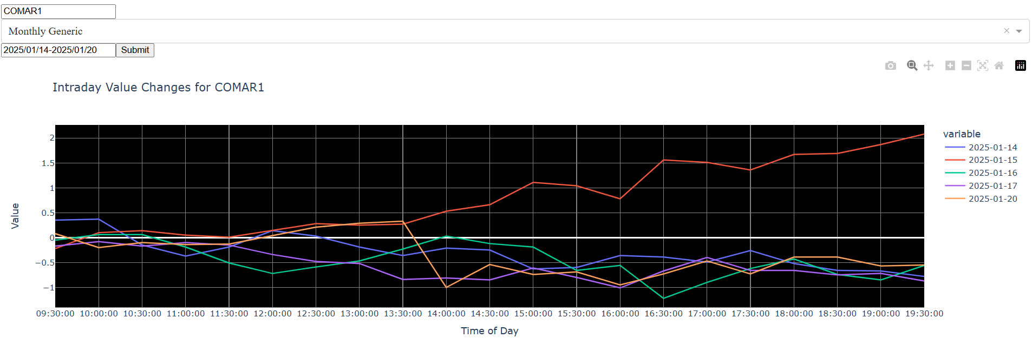
Intraday Seasonality Plot (example output)
Flexible input parameters
If out of bounds of data or contract expired, plot will not show for those dates

Slide 8
Getting Time Spreads
From a tuple we can get two monthly generic forms e.g. (‘DEC’, ’JUN’) can give us CODEC1 and COJUN1 for crude oil
Output a specific spread, e.g. ['COZ25', 'COM26’], for which the corresponding prices can be found (if given the data)
Given (monthA,monthB), look at the expiry dates of CO{monthA}1 and CO{monthB}1 in relation to the input date to determine the spread
If exp_date of CO {monthA} 1 < exp_date of CO {monthB} 1, find the specifics for CO {monthA}1, CO {monthB} 1 in that order
Gives CO {monthA} {monthB}1, CO {monthA}1{monthB}1
If exp_date of CO {monthB}1 < exp_date of CO {monthA}1, find the specifics for CO {monthA} 1, CO {monthB} 2
Gives CO {monthA} {monthB}1, CO {monthA}1{monthB}2

Slide 9
Getting Time Spreads (example output)
get_spreads("CO", [('DEC', 'JUN'), ('DEC', 'JUL')], "2025/04/30")
returns
{('CODECJUN1', 'CODEC1JUN1'): ['COZ25', 'COM26'], ('CODECJUL1', 'CODEC1JUL2'): ['COZ25', 'CON26’]}
(yet to find a way to do this without using the product code input)

Slide 10
Intraday Cumulative Volumes vs Historical Avg
Get relevant filtered data – but using the function twice
Once for getting data, as before, within the input date range (startdate-enddate)
Another time for getting historical data <= start_date
First dataset: group by the date and apply cumsum() on the volume for that specific contract
Second dataset: find the average cumulative volume for each time (09:00 to 19:00) across all the dates
Combine the datasets on the times, plot each column (including hist. avg)

Slide 11
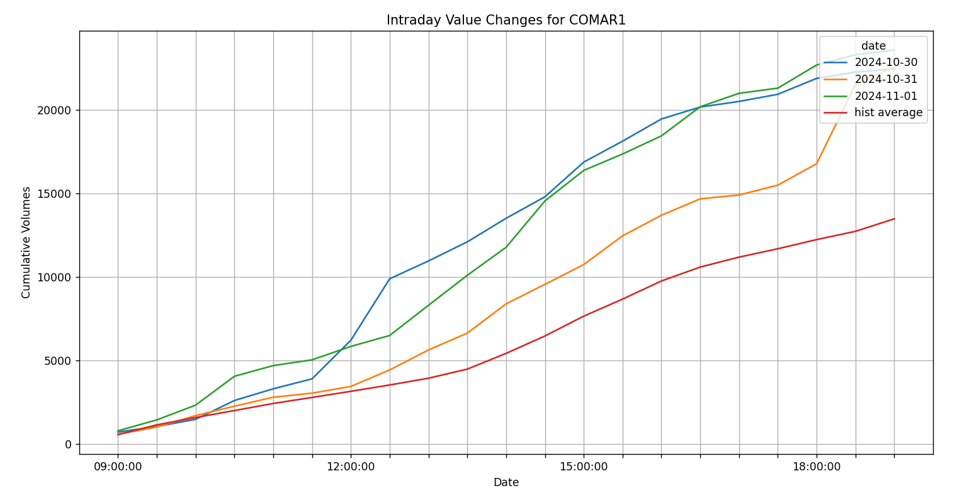
Intraday Cumulative Volumes vs Historical Avg (example output)
Done using matplotlib due to time constraint, but can easily be added to previous dash app
We see that volumes consistently exceed the historical avg throughout the day

Slide 12
Future Work
Aside from: analysis of price z-score of continuous front month contract/cumulative price moves over time frame
VWAP as reflection of market sentiment – test entry/exit points
Regress WTI on Brent, ADF test to see if the spread is stationary and whether mean-reversion can be traded on
Integrate macroeconomic data e.g. effect of interest rates/inflation on long term trends of futures prices

